Slide 1
OVATION Awards
Evaluator Training
Wednesday January 31, 2024

Slide 2
Training overview
OVATION Awards Divisions
Evaluating the Awards
The Evaluation Process
Q & A

Slide 3
The gift of feedback
As an evaluator, you have the opportunity to positively influence the professional development of entrants, contribute to the communication profession while enhancing your own strategic communication skills.

Slide 4
The mindset of an evaluator

Slide 5
Aligned to Gold Quill Awards
The IABC/Toronto OVATION Awards program is aligned to IABC’s global Gold Quill awards and the national Silver Leaf awards programs - making it easier for applicants to draft one entry for multiple awards.

Slide 6
OVATION Awards divisions
Division 1: Communication Management
Division 2: Communication Research
Division 3: Communication Training & Education
Division 4: Communication Skills

Slide 7
Division 1: Communication Management
This division covers projects, programs and campaigns guided by a communication strategy.
Entrants must demonstrate how their project applied a full range of planning and management skills, including research, analysis, strategy, tactical implementation and evaluation.
The entry must explain the links between the business need, stakeholder analysis, goals and objectives, and solution.
The entrant must explain the “why” of the planning and implementation to demonstrate their understanding of strategic communication planning and execution.

Slide 8
Division 2: Communication Research
This division recognizes the importance of research and measurement as a foundation for strategic communication work and a competency that is integral to success throughout the career of a communication professional.
Entries in this division should explain the plan, how it was developed and implemented, and the links between the business need, stakeholder analysis, goals and objectives, and solution.
Entrants must explain the “why” of the planning and implementation to demonstrate their understanding of strategic communication planning and execution.

Slide 9
Division 3: Training & Education
This division recognizes the training and education role of consultants and communicators in developing and delivering workshops, classes, seminars or training.
Entries may include communication training delivered within an organization, by consultants or in-house staff, and training and education via university classes, conferences, seminars, or workshops.
Includes training or education to develop or enhance communication competencies or skills as identified in the Global Standard of the Communication Profession’s six principles – ethics, context, analysis, consistency, engagement and strategy.

Slide 10
Division 3: Training & Education
Entries in this division must demonstrate:
Alignment of learning outcomes to goals and objectives
Alignment of assessments to specific learning outcomes
Theories and practices of educational excellence
Impact outside the classroom

Slide 11
Division 4: Communication Skills
This division includes marketing and communication elements that showcase technical skills such as editing, writing, design and multimedia production.
Entries in this division are generally tactical in nature and are often part of a larger campaign.
The entrant may be in the foundation career level where they are not involved in strategic communications planning.
While this division does not evaluate strategic planning ability, work worthy of an IABC award should contribute to the success of the organization.
This division does not use a work plan.

Slide 12
Evaluating the awards

Slide 13
Only SMART submissions win

Slide 14
IABC’s 7 Point Scale of Excellence
Starting point at 4

Slide 15
Awards of Merit and Excellence

Slide 16
Best of the Best Award
The cutoff for ‘Best of the Best’ is an overall score of 6.0 or higher, above the Award of Excellence cutoff of 5.75. This will create a small pool because most Excellence winners have an overall score of between 5.75-5.99.
If evaluators score an entry at 6.0 or higher, and wish to propose the entry for ‘Best of the Best’ honors, we ask that they write a few sentences explaining why they recommend it.

Slide 17
Selecting the Best of the Best
Once all evaluations are complete, a committee will review all entries that scored 6.0 or higher.
The ‘Best of the Best’ Award will go to ONE entry which best demonstrates:
Innovative thinking/unique approaches
Work that raises the standards of the communication profession/drives the profession forward
Work that leads to outstanding business or social outcomes

Slide 18
The evaluation process

Slide 19
Conflict of Interest
Check your entries immediately upon receiving them for any conflicts to allow for any conflicting entries to be reassigned to another evaluator

Slide 20
What you might see
Entered in the wrong category
Work plan over 4 pages
No cohesive story
TMI - too much information
Missing metrics
Missing client letter
Missing Work Sample

Slide 21
Disqualification
Submissions will be disqualified if:
Ethical standards not met
Work plan exceeds four pages
Entry doesn’t support work samples
Work isn’t completed within the time required (3 years prior to Dec 31, 2023)
Contact the IABC/Toronto VP Programs and provide a detailed explanation of why you think the submission should be disqualified

Slide 22
I am honest. My actions bring respect for and trust in the communication profession.
I communicate accurate information and promptly correct any errors.
I obey laws and public policies; if I violate any law or public policy, I act promptly to correct the situation.
I protect confidential information while acting within the law.
I support the ideals of free speech, freedom of assembly, and access to an open marketplace of ideas.
I am sensitive to others cultural values and beliefs.
I give credit to others for their work and cite my sources.
I do not use confidential information for personal benefit.
I do not represent conflicting or competing interests without full disclosure and the written consent of those involved.
I do not accept undisclosed gifts or payments for professional services from anyone other than a client or employer.
I do not guarantee results that are beyond my power to deliver.
IABC’s Code of Ethics

Slide 23
Evaluating process

Slide 24
Evaluating process
Evaluate the awards first on your own
Each one takes approximate 1-2 hours
You will receive an email with information on your judging partner and how to access your assigned entries from Amie
Commit to a timeframe with your partner to reconcile together
After you have evaluated the entries on your own, then reconcile each score in each section with your partner each score must match exactly

Slide 25
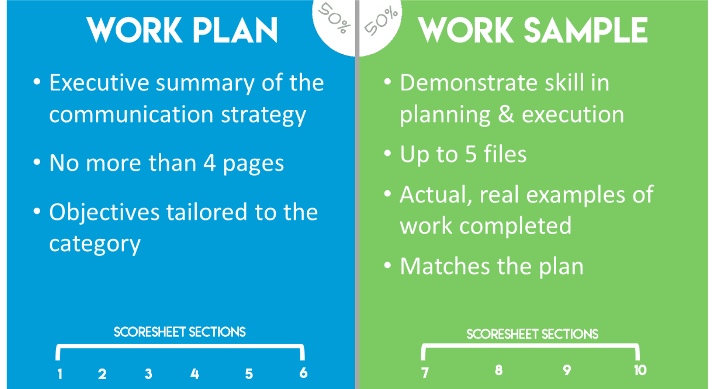
Scoring a submission
For Division 1, 2 & 3 you evaluate a Work Plan and a Work Sample
There are 10 sections on the score sheet for each division

Slide 26
Scoring a submission

Slide 27
Scoring a submission

Slide 28
Scoring a submission

Slide 29
What to keep in mind
Submissions evaluated against a rubric
What you see is what you evaluate
Don’t evaluate based on how you would have delivered the project
Evaluate based on what is reasonably expected
Don’t make assumptions

Slide 30
Using the rubrics

Slide 31
Making
comments

Slide 32
Making
comments

Slide 33
Reconcilliation

Slide 34
Top 10 tips
Review the resources available on the Gold Quill Award website—especially the Evaluating Excellence Guides and score sheets.
As soon as you receive your entry assignments, review them for potential conflicts of interest. If you find you cannot evaluate an entry, contact the Awards Manager or Coordinator immediately so the entry can be reassigned.
Reach out to your partner and agree on a time frame for reconciling entries.
Review the work plan and work sample carefully for a full understanding of the entry.
Have the Evaluating Excellence guide for the appropriate division available to follow while scoring.
Strive to be objective. Many evaluators find that a scoring especially low or high on one item can have a ripple effect on the following items. As much as you can, reset your thinking as you approach each section to guard against this bias. Referencing the rubrics will help.
Ensure there are measurable objectives included in the entry for a score of 4, which is professionally competent. Division 1, 2 & 3 entries should have outcome-based objectives to demonstrate award-worthy work. Outcome-based objectives measure what the audience gains from the communication by way of awareness, understanding, recall, perception, attitudes, opinions and behaviors.
Provide quality feedback that mentors and coaches entrants. For low and high scores, provide comments that will help the entrant understand how they can improve; for high scores, let them know what you thought was exemplary.
Once you have completed scoring an entry, double check it to ensure no missing scores and that feedback is grammatically correct, written in a positive tone, and without spelling errors.
Have an honest discussion when reconciling entries with your partner. Be sure to review scores and comments so comments align to the score and do not contradict each other.

Slide 35
Deadlines
Extended submission deadline - Feb 5
Evaluations start - Feb 9-March 9
Finalize all scores and comments
- March 9

Slide 36
Resources
The Global Standard of the Communication Profession (iabc.com)
Judges Resources - IABC/Toronto OVATION
Resources for Entrants - IABC/Toronto OVATION
IABC/Toronto OVATION Awards

Slide 37
Resources

Slide 38
And finally please remember…..
Your scores must match exactly in each category with your scoring partner
Include a constructive comment for each score, ensure your comments are aligned with your partner
Check your final overall score to see whether it is an Award of Merit or Award of Excellence or close to one.
If the score is close to a 5.25 or 5.75, please have the discussion as evaluators whether it could be an award winner and the scores adjusted
Don’t wait to the last minute. Give yourselves and the entrants the opportunity for a fair evaluation
Have fun!!

Slide 39
Questions
Type them in the chat box.
If you have a question after today, send them to:
Toronto-Programs@iabc.to

Slide 40
Thank you!

